Slide 1
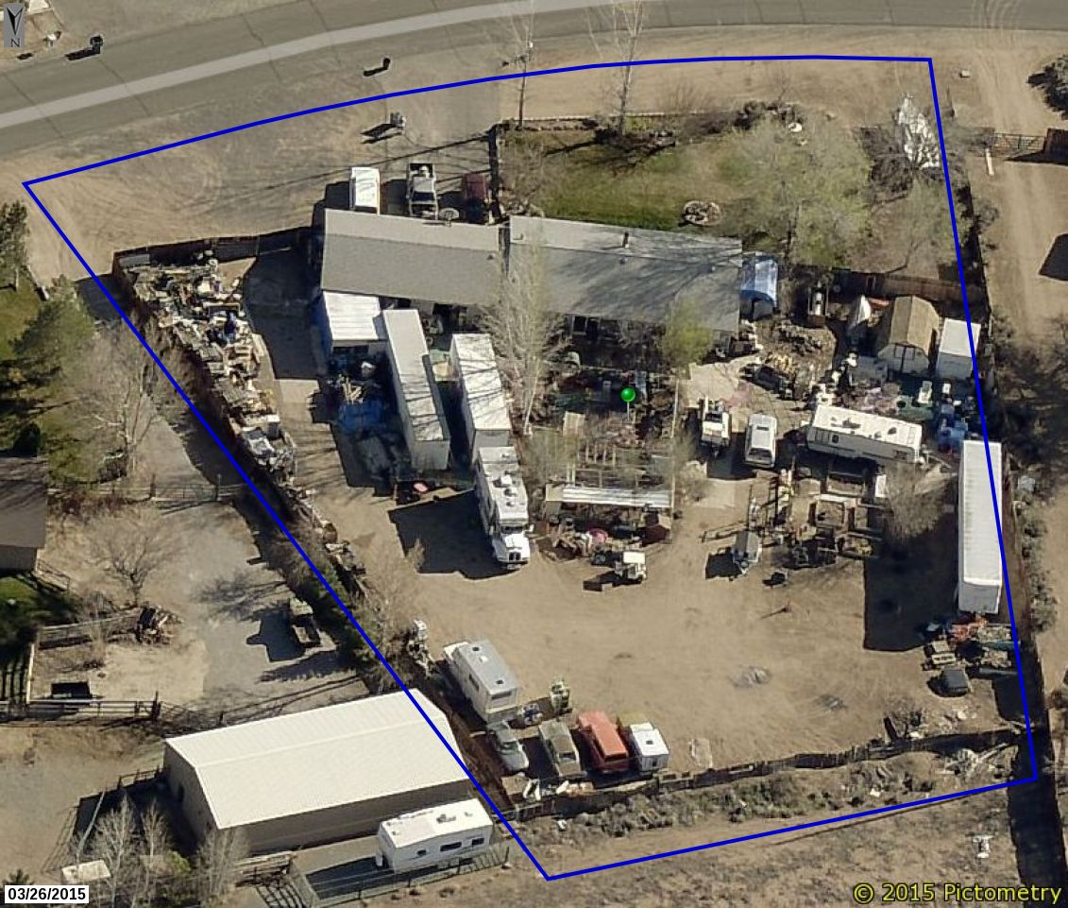
Washoe County Board of Adjustment
WVIO-PLA18-0283 (Ruiz Appeal)
December 6, 2018

Slide 2
Background/Overview
Appeal of an administrative hearing officer’s decision
What does that mean?
A property owner has been found in violation of Washoe County Code (WCC) by both code enforcement (CEO) staff and an administrative hearing officer; and,
The property owner has appealed these findings per WCC Chapter 125, Administrative Enforcement Code
First such case to be heard by the Board of Adjustment (BOA) since adoption of WCC Chapter 125

Slide 3
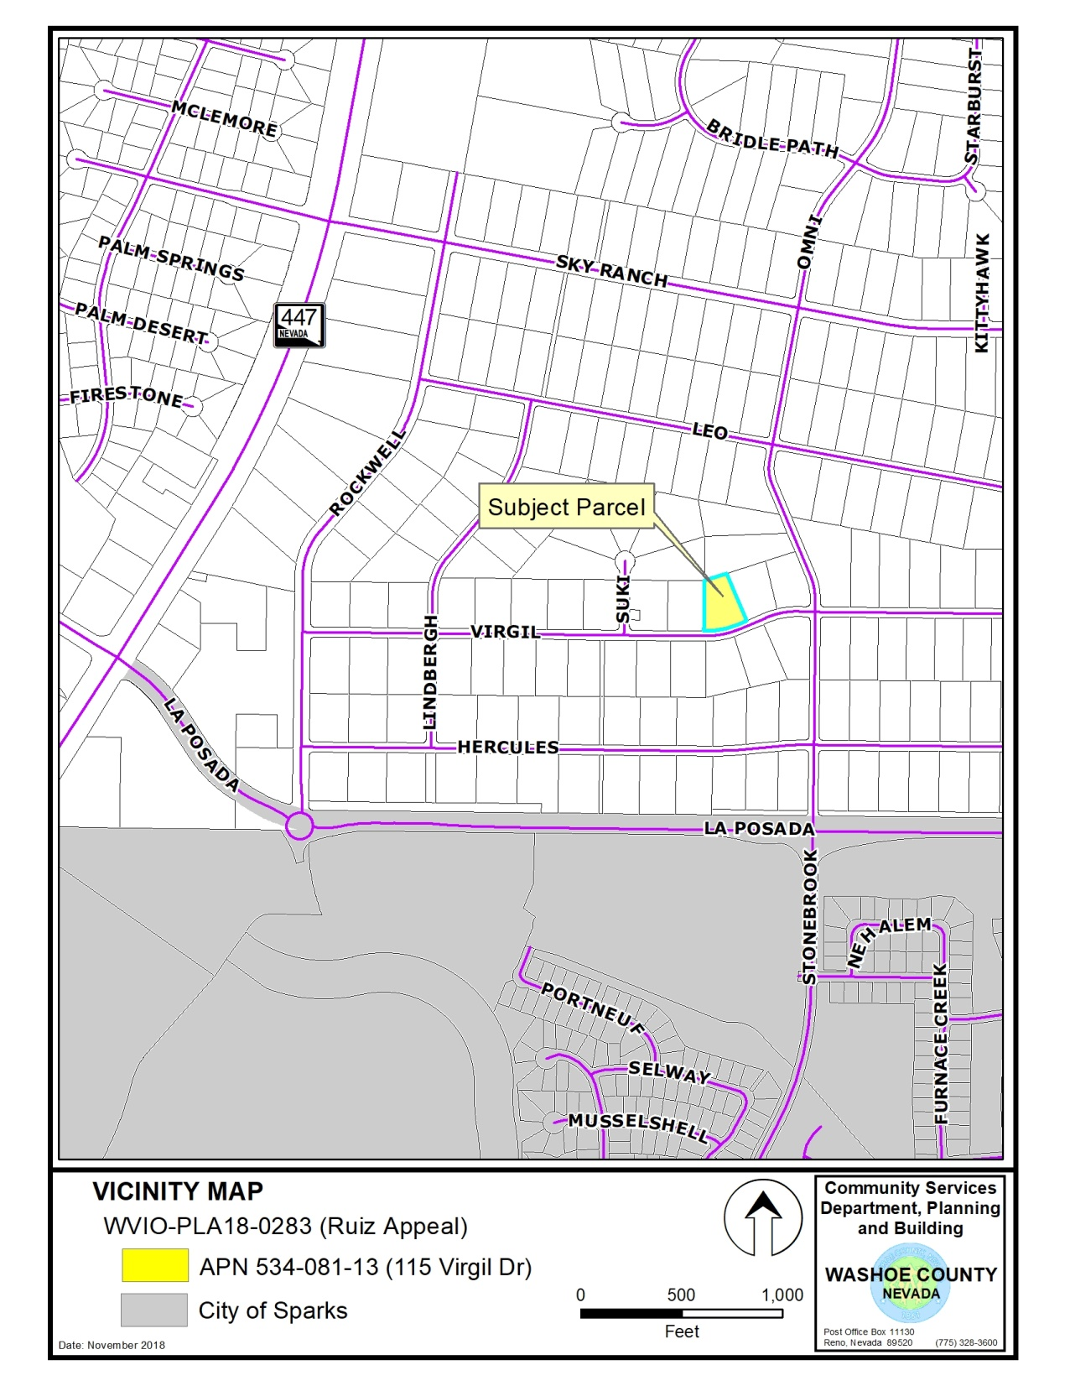

Slide 4
Background/Overview
Anonymous complaint received June 26, 2018 alleging the following was occurring at 115 Virgil Drive:
  That a mechanic shop was being run from the home;
  Commercial vehicles were being stored on the property
  Junk vehicles were also being stored on the property
Upon investigation, the CEO confirmed that a commercial vehicle was visibly stored on the property
But no illegal business activity or junk vehicle violations were observed

Slide 5
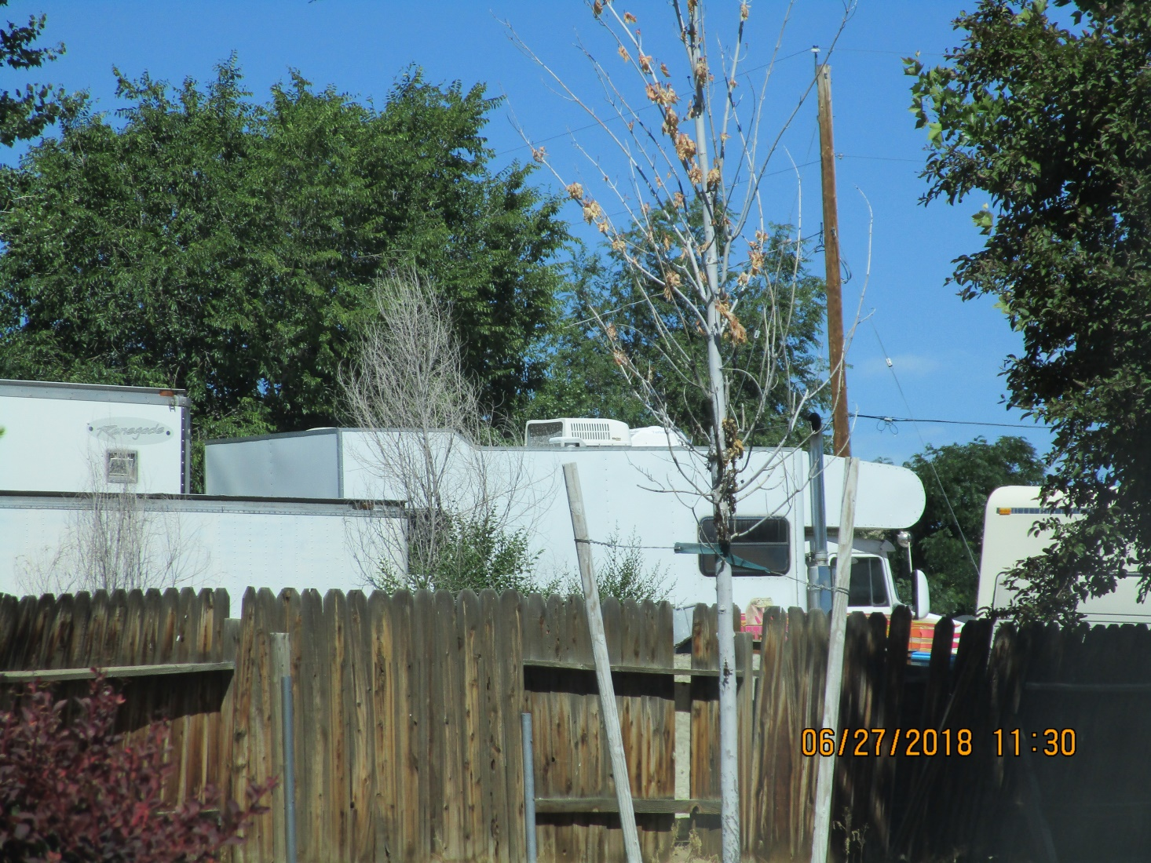
Background/Overview

Slide 6
Background/Overview

Slide 7
Background/Overview
Violation of WCC 110.306.35(c), Outdoor storage of commercial vehicle(s) on a residentially zoned property
Enforcement per WCC Chapter 125, Administrative Enforcement Code – enabled by 110.910.15(d)
Administrative enforcement procedures include a process for warnings and then escalating penalties if a violation is not corrected
Issuance of an administrative warning is the first step in the enforcement process – 30 days to correct violation (or agree to a compliance plan)

Slide 8
Background/Overview
Property owner did not contact CEO staff after receipt of the administrative warning notice
Due to lack of contact and no correction after 30 days, a penalty notice was issued ($100 fine)
Per WCC Section 125.240, a respondent may appeal an administrative penalty notice
Appeal is a request for a hearing by an administrative hearing officer (and is in lieu of paying the penalty)
Not a hearing examiner

Slide 9
Background/Overview
Appeal request stays enforcement proceedings until the hearing officer renders a decision
Administrative hearing officer decides, based on the evidence presented and testimony provided:
  If a violation of WCC occurred as alleged by the code enforcement officer; and,
  The remedy (method of correction, assessment of penalty, dismissal, remand, etc.)

Slide 10
Background/Overview
Appeal was heard on September 19, 2018
Hearing include presentation of arguments and evidence by both sides (see Exhibit A, Record on Appeal)
Hearing officer found that a violation of WCC Section 110.306.35(c) had occurred
Issued an Administrative Order requiring the commercial vehicle to be removed no later than December 1, 2018 (but waived the $100 penalty)

Slide 11
Background/Overview
WCC Section 110.910.15(d) Administrative Enforcement Proceedings provides the following appeal rights (under a WCC Chapter 125 enforcement action/proceeding):
  Appeal to Board of Adjustment. Any aggrieved person may appeal a decision or order of an administrative hearing officer to the Board of Adjustment in accordance with the Rules of the Board of Adjustment.

Slide 12
Background/Overview
BOA review considerations on such appeals are outlined on pages 4 and 5 of the staff report
BOA tasked with affirming, modifying, reversing, or remanding the administrative hearing officer’s decision
May consider the record on appeal (Exhibit A), evidence presented by the appellant, testimony received at the public hearing, and any other evidence deemed relevant by the BOA
BOA decision is final for purposes of judicial review – no appeal to BCC; 25 days to file court petition

Slide 13
Analysis
WCC Section 110.306.35(c) states that no storage of commercial vehicles shall be allowed on any residentially zoned parcel, unless specifically regulated in another section of the code
The 1 acre property is zoned LDS – classified as a residentially zoned property
The subject vehicle is a commercial vehicle based on the definition provided by WCC 110.306.35(c)(1)
Exceptions to the storage of commercial vehicles not applicable

Slide 14
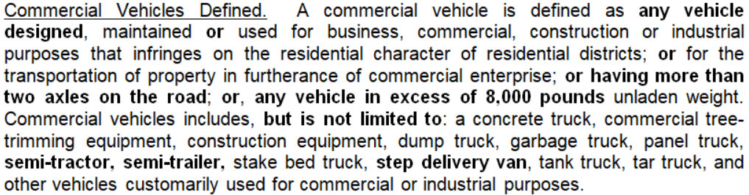
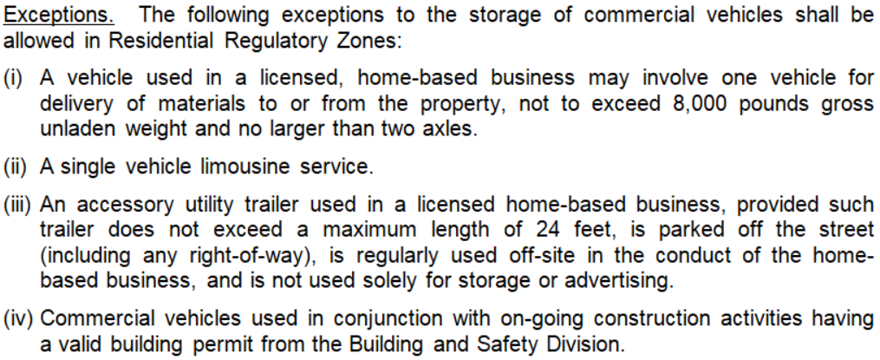
Analysis

Slide 15
Analysis
The subject vehicle meets the definition of a commercial vehicle in three ways:
  The vehicle was originally manufactured and designed as a commercial vehicle;
  The vehicle has more than two axles on the road (see pictures included with Tab 1 of Exhibit A); and
  The vehicle exceeds 8,000 pounds gross unladen weight (see the 2017n vehicle registration included within Tab 1 of Exhibit A, or Exhibit C)

Slide 16
Analysis
The appellant has argued that the subject vehicle has been converted to a Recreational Vehicle (RV); and,
Therefore qualifies for the exemption provided by WCC Section 110.306.35(d)(4) which states:
  “Registered recreational vehicles and campers and items typically associated with and used for personal outdoor recreation. Examples of recreational vehicles and items include, but are not limited to, motorized campers, fifth wheel campers and camper trailers, boats and personal watercraft, and motorcycles”

Slide 17
Analysis
The vehicle is registered by the DMV as a Truck Motor Home RV conversion; however,
The DMV registration process only verifies that all components of a RV are in place (e.g. grey water holding tank, toilet, sink, sleeping area, etc.)
Registration by the DMV is irrelevant to the requirements/definitions of the Development Code
CEO staff interprets the RV exception to apply only to vehicles designed and constructed as a RV, and not to vehicles converted from a commercial vehicle

Slide 18
Analysis
CEO position is that a vehicle remains classified as it originated from the factory regardless of any subsequent modifications (+ other def. provisions)
The appellant has also argued that in other enforcement cases, the hearing officer did find that a RV conversion was not a commercial vehicle
Hearing officer decisions are not precedent setting - there are often conflicting decisions / outcomes
Staff did not agree with that decision and believes it was not based on a valid interpretation of the code

Slide 19
Public Notice and CAB
Public notice is not required as part of an administrative enforcement action
Only noticing requirement is to notice the violator / appellant and provide due process
The appellant has been provided notice and due process as required by Chapter 125
CAB review and/or input is not part of an administrative enforcement action

Slide 20
Reviewing Agencies
No other agencies have been involved in this administrative enforcement action

Slide 21
Findings
The BOA is not required to make specific findings in reaching a decision on this appeal
Public record is sufficient
A written order of the BOA’s decision will be prepared, executed by the BOA Chair, and filed with the Secretary of the BOA
A copy of the order is served on the appellant
If the appeal is denied, the BOA should include in the written order / decision a compliance plan (e.g. remove the vehicle by x date)

Slide 22
Possible Motion
I move that, after giving reasoned consideration to the information contained in the staff report and information received during the public hearing, the Washoe County Board of Adjustment deny this appeal and uphold the decision of the administrative hearing officer that the appellant violated WCC Section 110.306.35(c), Outdoor storage of commercial vehicle(s) on a residentially zoned property; and, authorize the Chair of the Board of Adjustment to prepare a written order of the decision and file it with the Secretary of the Board of Adjustment, a copy of which shall be served to the appellant.

Slide 23
Appeal Process
The appellant has the right to appeal the written order by filing a petition for judicial review in the Second Judicial District Court for the State of Nevada within 25 days from the date the order is mailed to the appellant. Per WCC Section 110.910.15(i)(6), when a petition for judicial review is filed, the court rules shall govern the proceeding and the requested judicial review is in lieu of an appeal to the Board of County Commissioners as authorized by NRS 278.310(3)(b).

